Slide 1
Online Food delivery application

Slide 2
Project group
GROUP SIZE- 1
Rushikesh Chavan
Vyshnavi
Gowri Keerthana.P
Suma Madala
Usha Rani
Keerthi Penneti
d

Slide 3
CONTENTS
1.Introduction
2.Problem Statement
3.Technologies used
4.Modules
5.Usecase diagram
6.Class Design
7.Swagger outputs
8.Docker & Commands
9.Kubernetes & Commands
10.Conclusion

Slide 4
online food delivery (ofd)
Online Food Delivery (ofd) is an application, which is the process of ordering food, for delivery or pickup, from a website or other applications.
The product can be either ready to eat food or food that has not been specially prepared for direct consumption.
The main purpose of an online food delivery system is to provide customer for a way to place an order at a restaurant over the internet.

Slide 5
PROBLEM STATEMENT
The People have to be present condition in taken food from Hotel that means People had to compulsion of goes to Hotel.
Now the moment the Online food ordering could be called the response of the internet to the desire for delivery food.
It is a growing trend especially in urban areas and on college campuses that allows people to order from restaurants featuring interactive menus, by use of their Internet connection.
There are several ways in which Online food ordering from a restaurant can have its own website with easy features for placing an order for pick-up delivery.
Some add a third option of being able to make reservations. Instead of calling for a delivery, people just access the Internet, head to the restaurant site and make their order.

Slide 6

Technology Used
Core Java +JPA with Hibernate +Postgre​ss
Spring Boot + Rest Controller + JPA with Hibernate​
3.Lambok+Sql+Postman+Swagger
4.Docker+Kubernetes+AWS+Putty+PgAdmin

Slide 7
modules
Admin
Module
Customer
Module
Food
Module
Order
Module
Delivery
Module
Category
Module
Cart
Module
Admin Details
Customer details
Food items details
Order details
Delivery details
Category details
Cart details

Slide 8
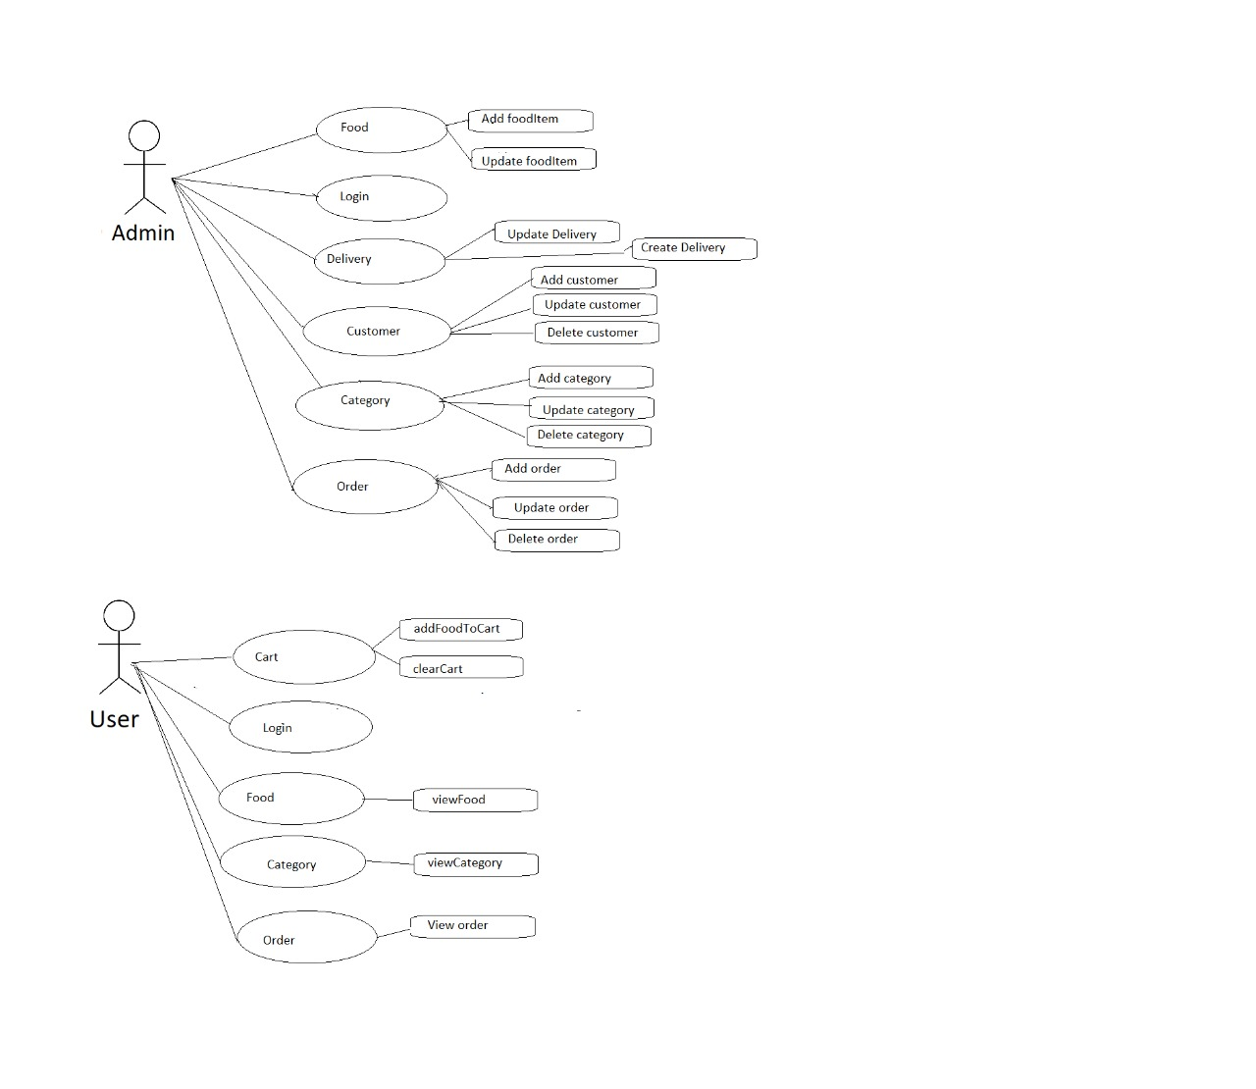
USE CASE DIAGRAM

Slide 9
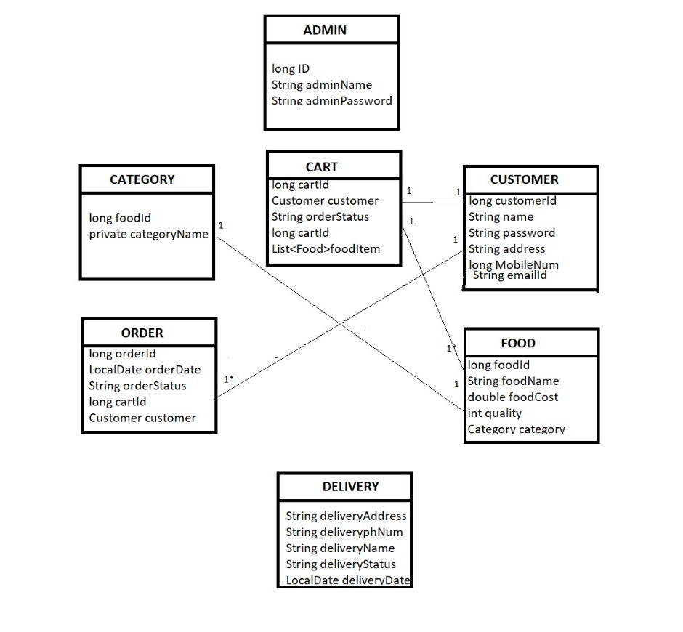
CLASS DESIGN
Service Interface

Slide 10
DOCKER
Docker is an open platform for developing, shipping, and running applications
The Docker platform allows you to package up your application and deliver them to the cloud without any dependencies.
Benefits of using docker
Flexible resource sharing
Scalability - many containers can be placed in a single host
Fast deployment, ease of creating new instances, and faster migrations.
Better security, less access needed to work with the code running inside containers, and fewer software dependencies

Slide 11
docker commands
docker --version - for knowing the docker version
docker ps - to get list of all running containers
Docker ps -a - to get list of all not running containers
docker stop containerID - to stop a container using its ID
docker images - to get list of images
docker rmi imagename - to remove images
docker run –d container name - to remove running container

Slide 12
kubernetes
Kubernetes is an open source orchestration software developed by google.
Benefits of using Kubernetes:
Reduced application development and release timeframes optimization of IT costs, increased software scalability and availability, flexibility in multi-cloud environments, and cloud portability.
Kubernetes Features
Auto-scaling
Load balancing
Persistent storage

Slide 13
Kubernetes commands
kubectl get services - to get a list of all services in the current namespace
kubectl get pods --all-namespaces - to retrieve a list of services in all namespaces
kubectl get pods --field-selector=status. Phase=Running - to list all running pods in a
namespace
kubectl logs <service_name> - Request service logs

Slide 14
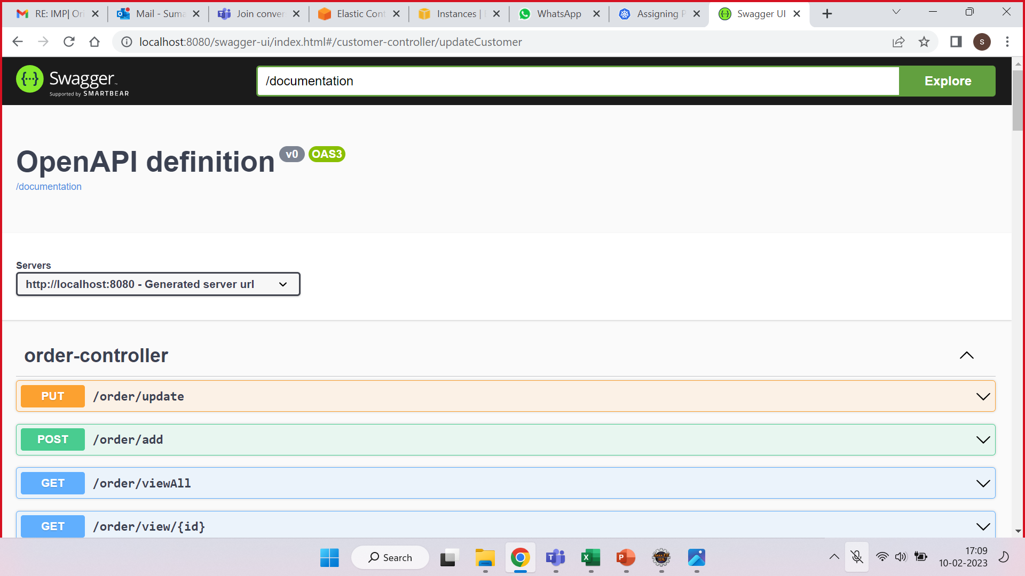
Swagger ui output

Slide 15
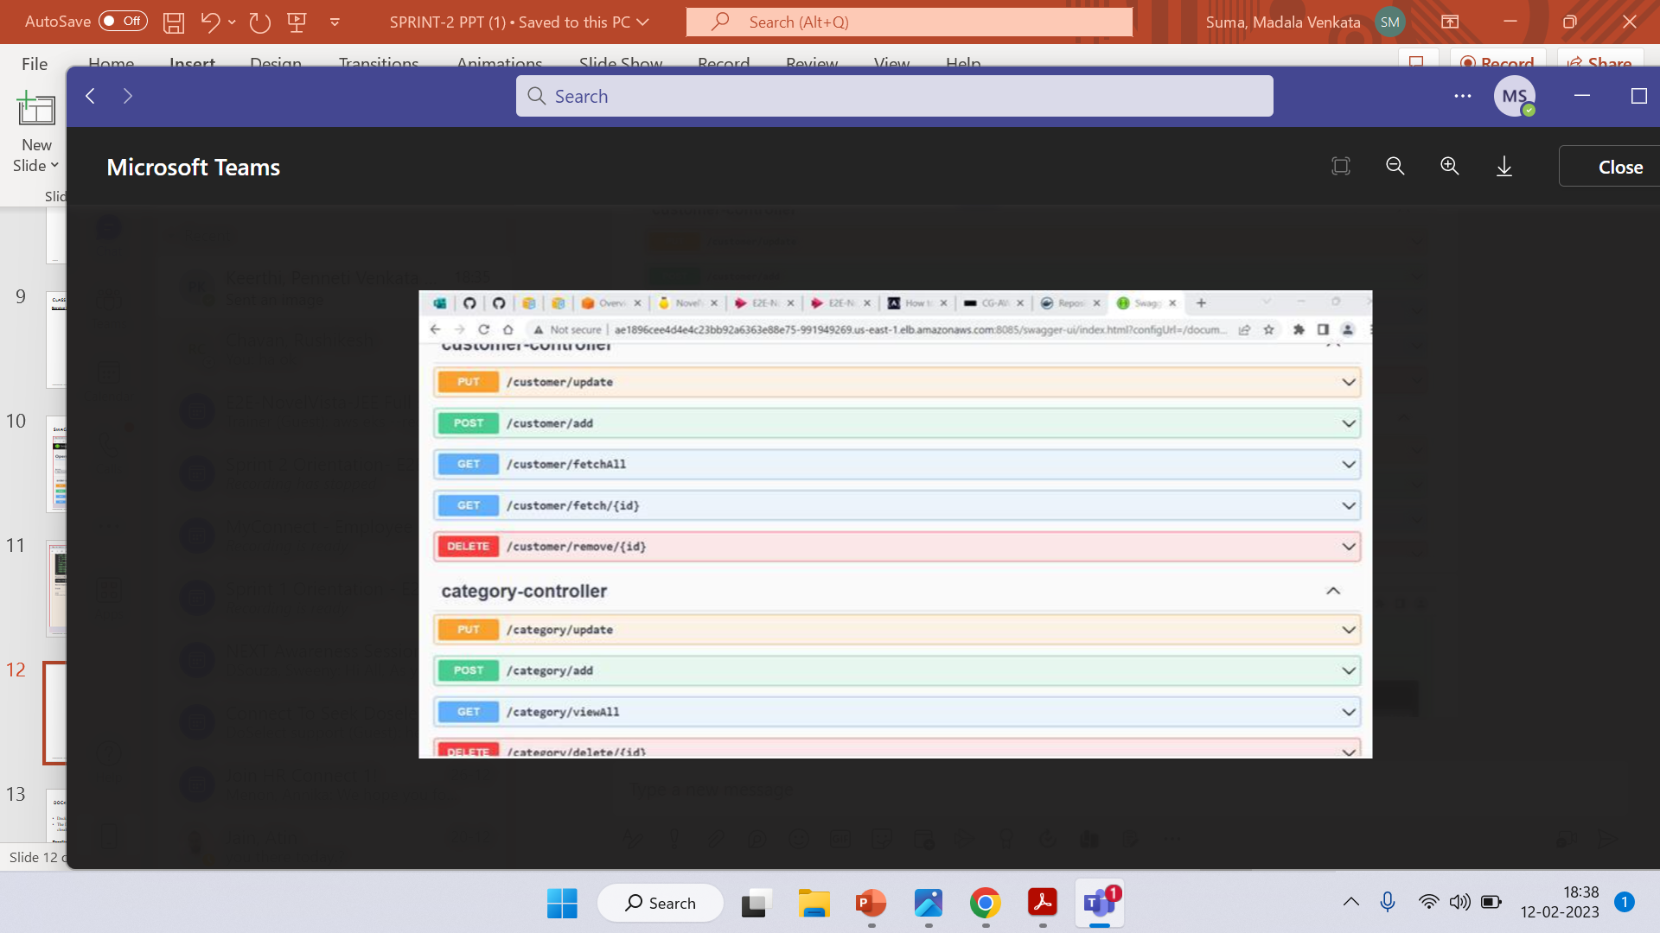

Slide 16
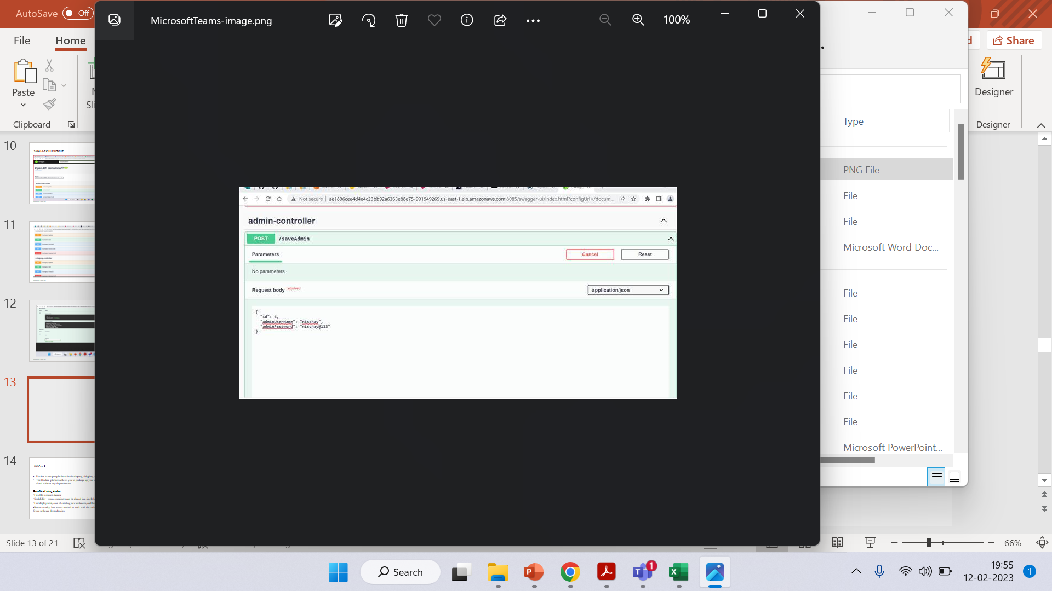

Slide 17
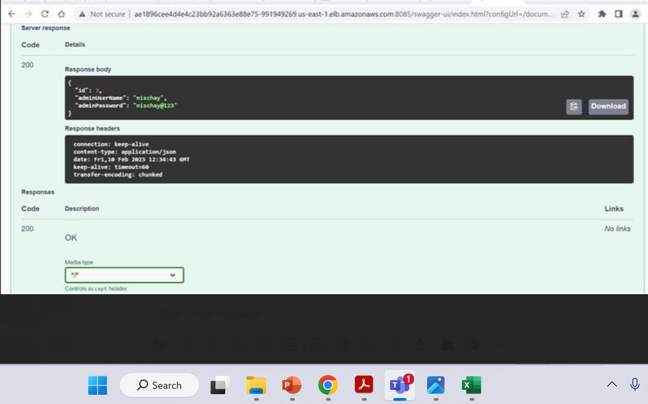

Slide 18
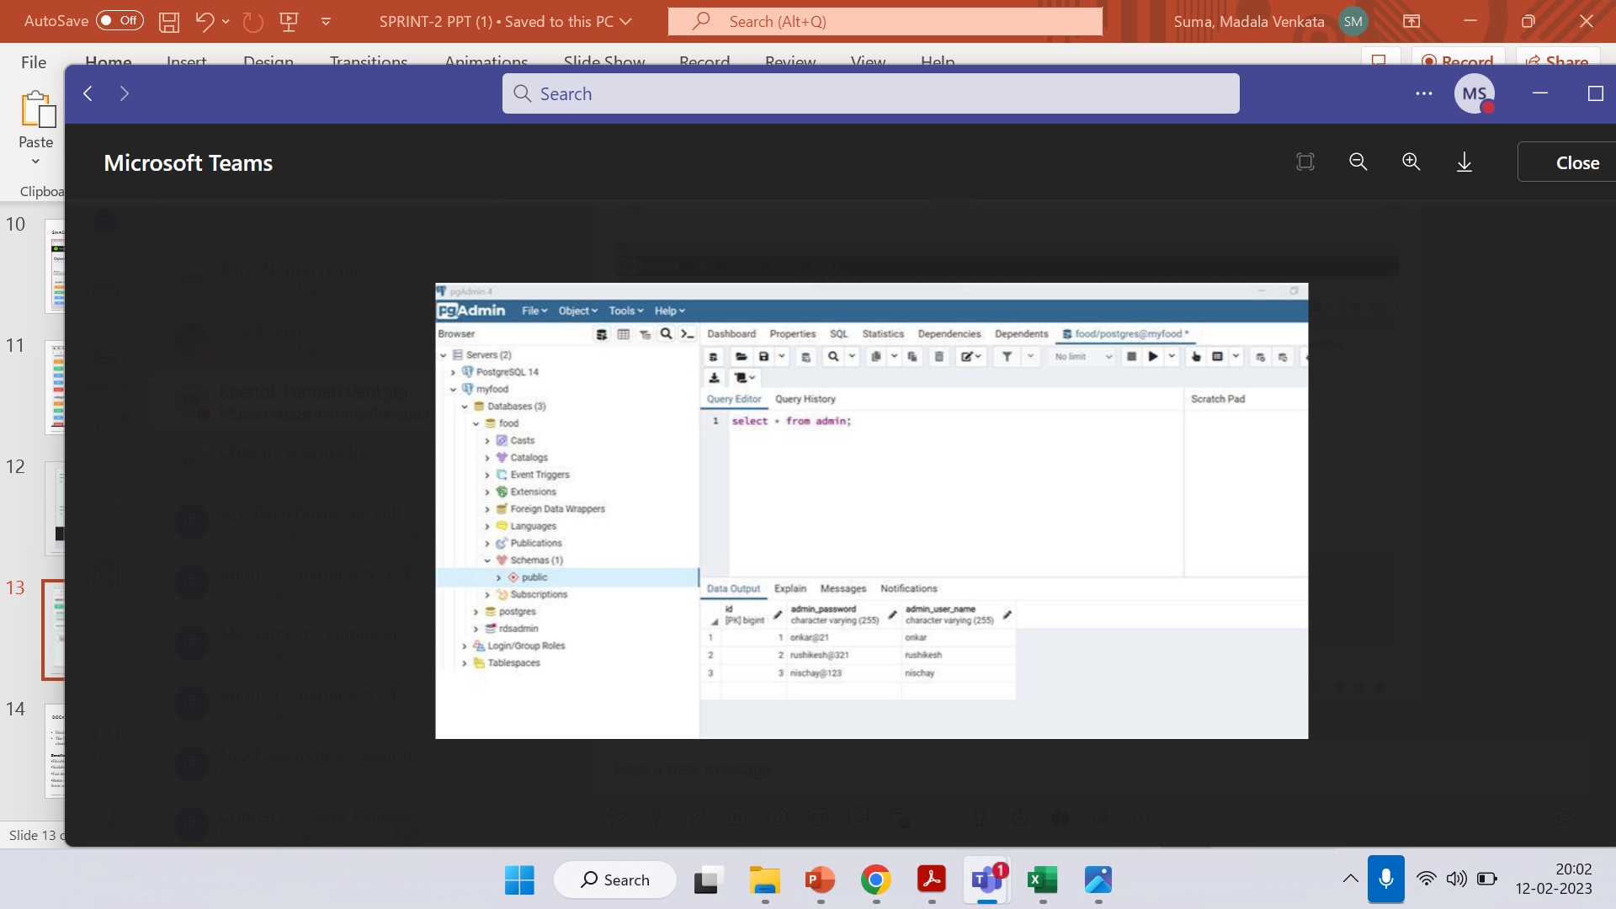

Slide 19
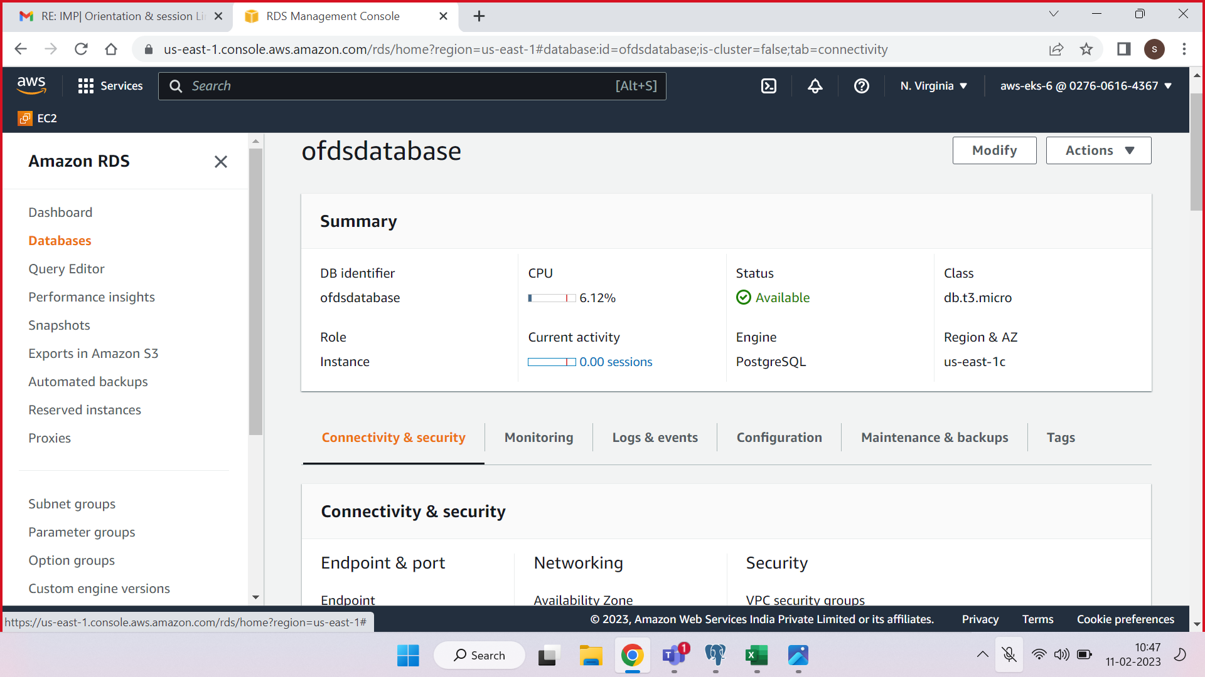

Slide 20
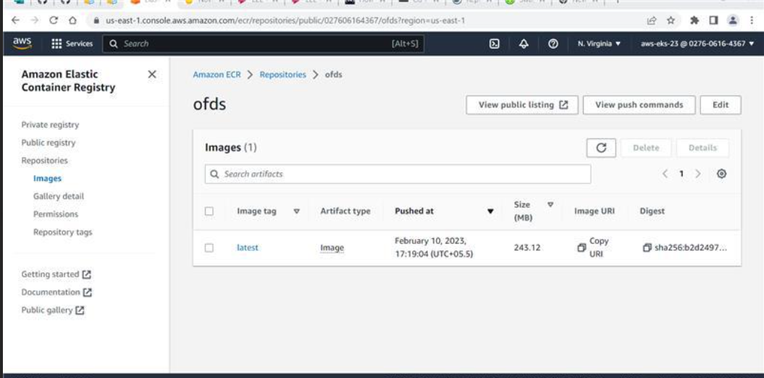

Slide 21
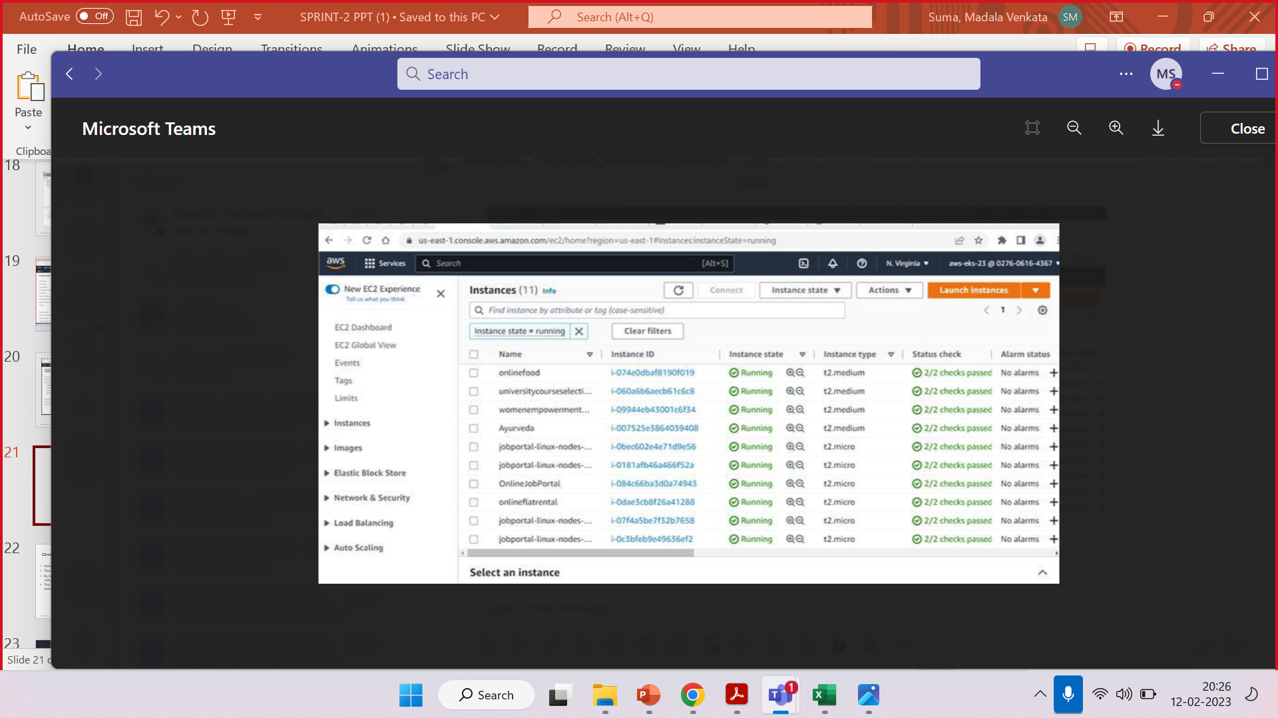

Slide 22
conclusion
Online Food Delivery Application has been successfully developed using springtoolsuite.
Then we have deployed this project into the AWS using docker and Kubernetes.
By the online food delivery application we can just order the food by just having a mobile with proper internet.
This application is user friendly as we are using online services which is easily understandable ,accessible and time efficient.

Slide 23

THANK YOU
capgemini.com

